Slide 1

Mosquitoes' wingbeat analysis

Slide 2
Use case of the product
Study mosquitoes' populations
Understand the behavior of different species
Help researchers
Multiple benefits for global health

Slide 3
System requirements
A low consumption autonomous trap
Attracts mosquitoes
Detects the presence of a mosquito
Reads and save each wingbeat
Results can be retrieved by a scientist

Slide 4
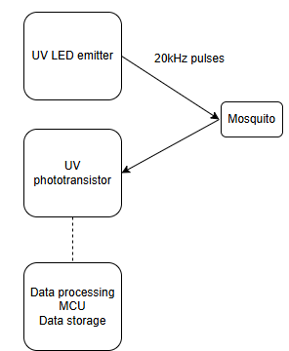
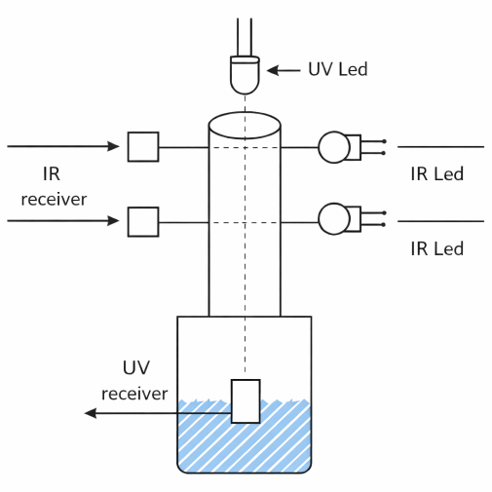

System global view

Slide 5
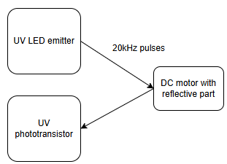
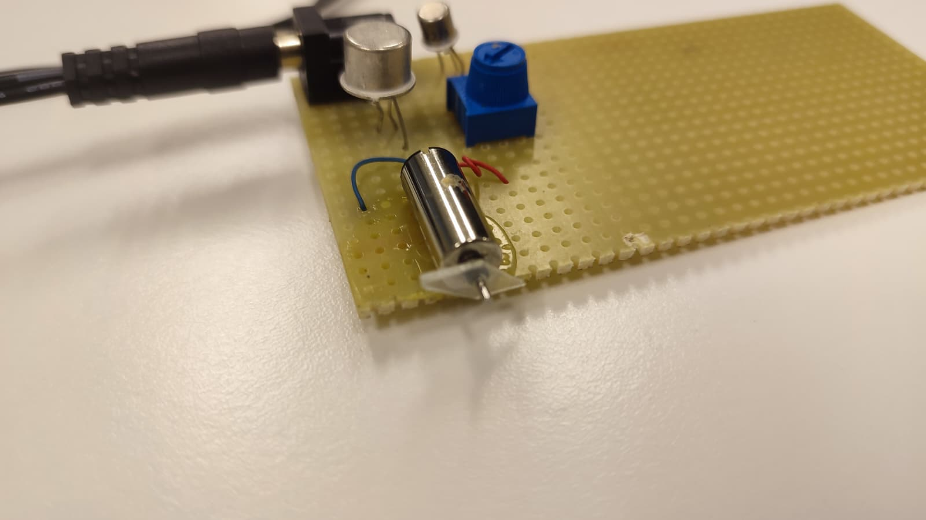
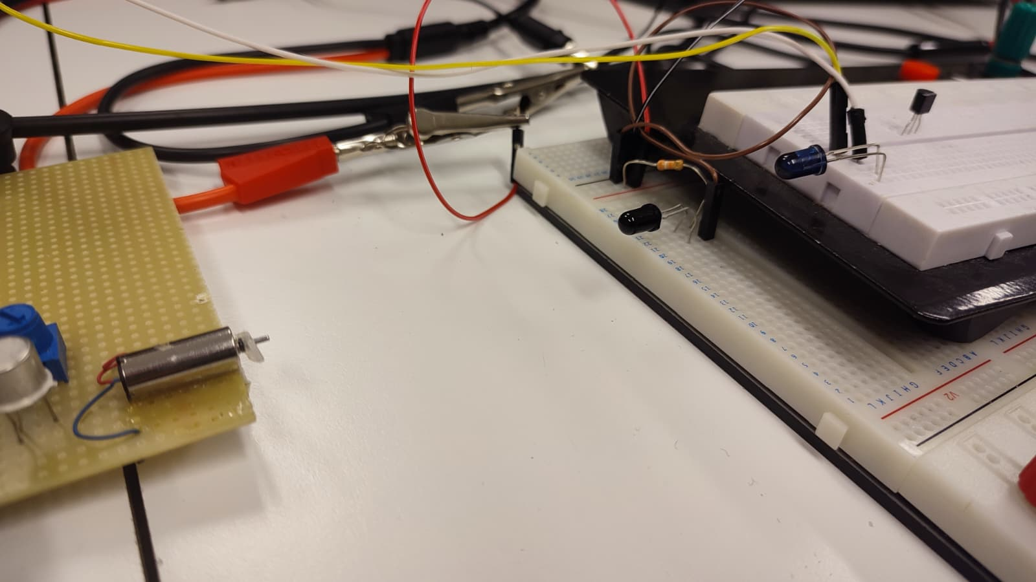
First proof of concept
DC motor to simulate the mosquitoes’ wings
Little to none modification of the pulses received as the UV beam is very narrow

Slide 6
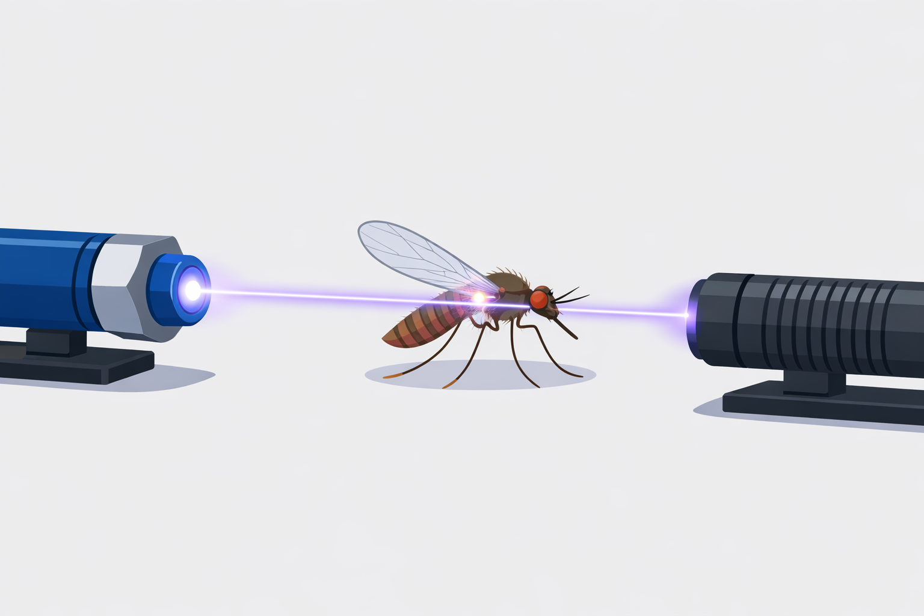
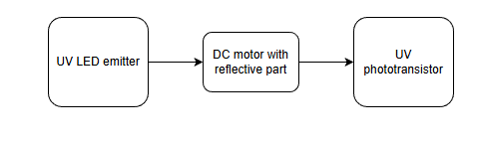
Second PoC
Better results as the reflective part really cuts the light beam
Realistic concept for the real system

Slide 7
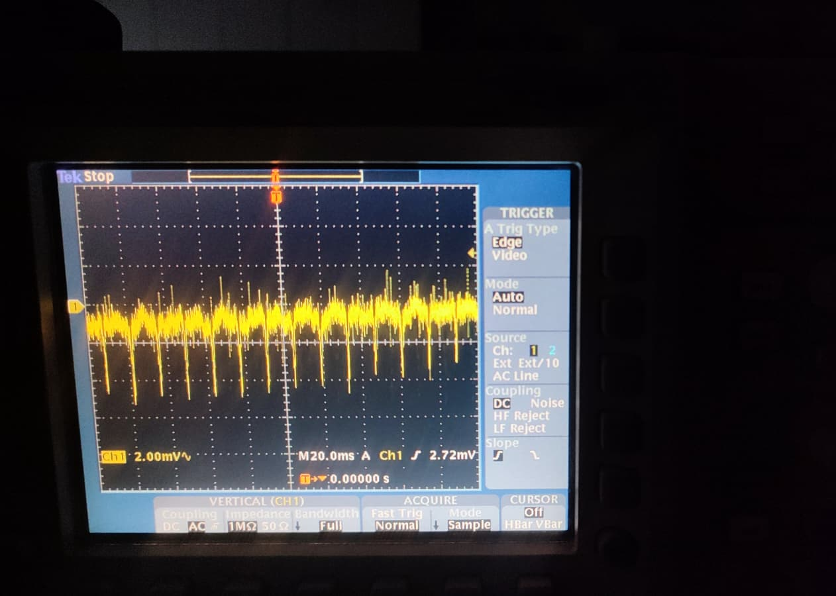
PoC results
The spikes are clearly separated from the noise
The amplitude is too low
More amplification is needed

Slide 8
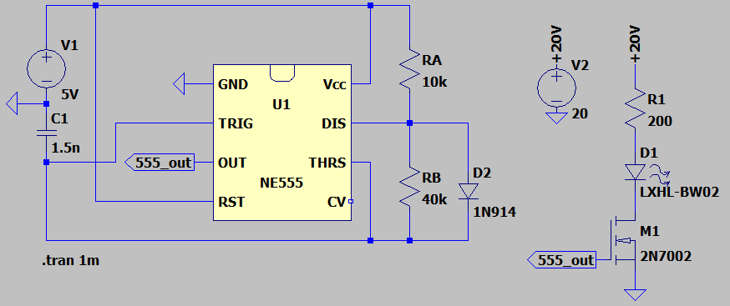
Simulation – UV LED circuit
High energy pulses
To increase the effective distance and the signal quality for the receiver
Without blowing out the LED

Slide 9
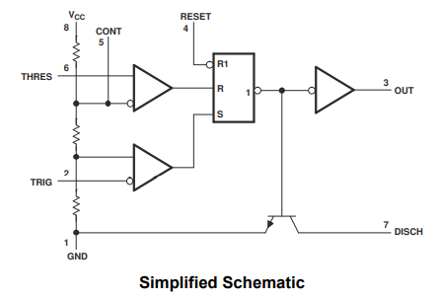
The 555 precision timer IC
A precision timer IC
Can be used as a pulse generator
Monostable, or bistable to produce flip-flop switching action
5-15V, 200mA → suitable to drive the MOSFET

Slide 10
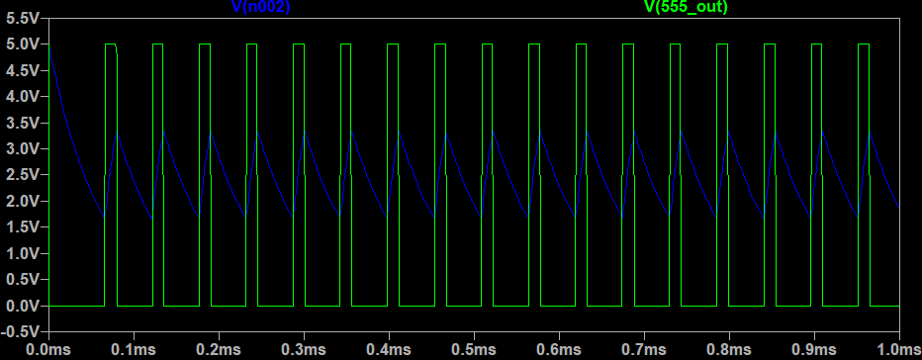
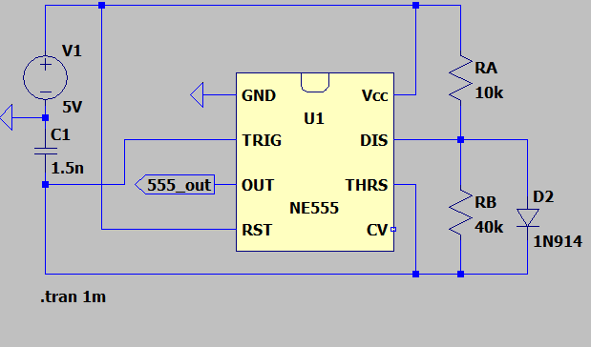
Capacitor charge and discharge
Diode to bypass the resistor when charging the capacitor to get a 20% duty cycle
Two internal voltage dividers for the threshold : Vcc/3 and 2Vcc/3
That is why the capacitor charge and discharge between 1,6v and 3,3V

Slide 11
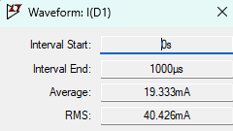
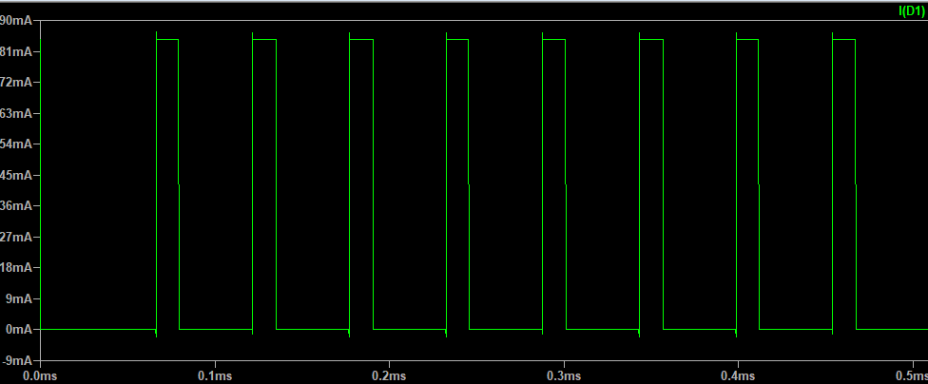
LED current
40mA RMS → reliable limit

Slide 12
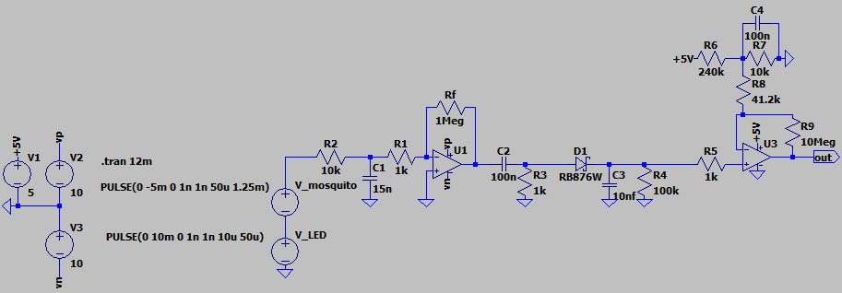
Signal processing simulation

Slide 13
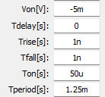
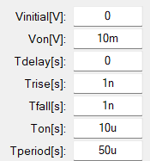
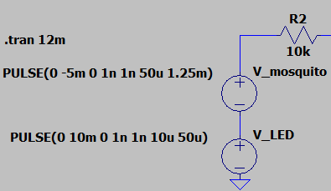
Simulation – parameters and assumptions
Parameters used to simulate the phototransistor’s output
Period for a wingbeat frequency of 800Hz

Slide 14
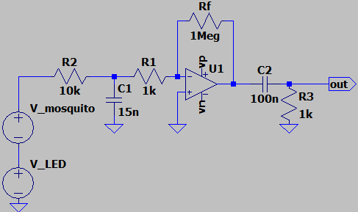
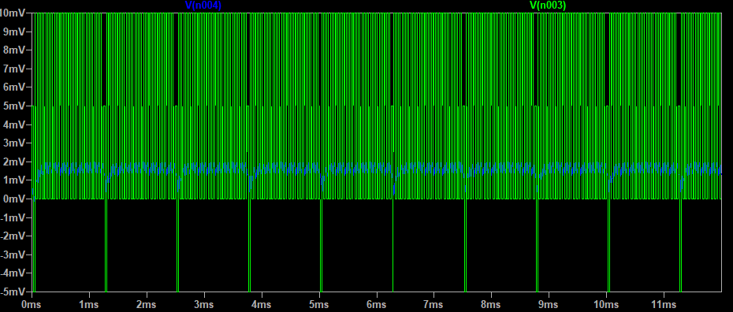
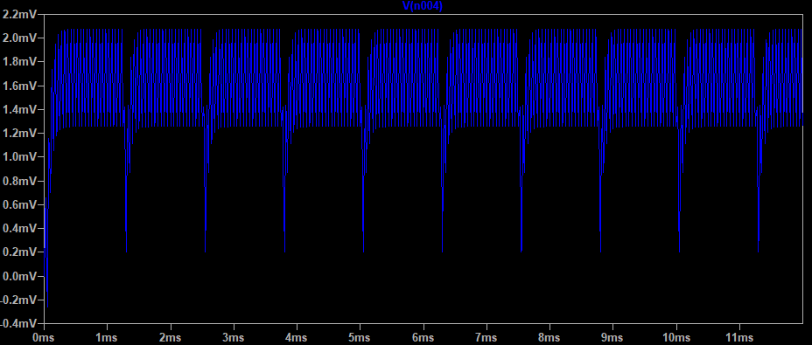
Simulation – low pass filter
Mosquitoes’ wingbeat vary between 600 and 1000Hz
We use a low pass filter to cut off the 20kHz signal from the LED (and some noise)
Cut off frequency (-3dB) of 1kHz

Slide 15
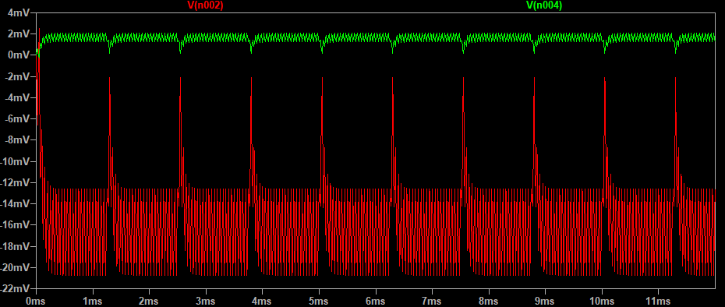
Simulation – inverting amplifier
Voltage inverting is done to get positive voltage spikes for easier microcontroller reading
For stability with a high gain (1000), the amplification should be done with 2 or 3 stages

Slide 16
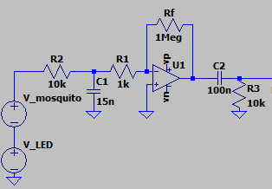
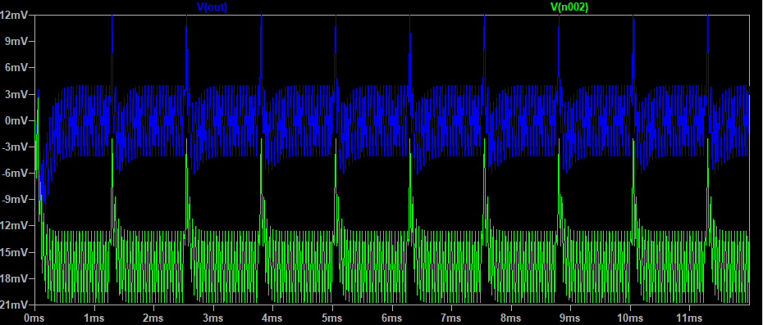
Simulation – high pass filter
Used to delete the DC offset
Fc=160Hz at -3dB
Pulses are very short (0,2ms) so another step is needed before the IC input

Slide 17
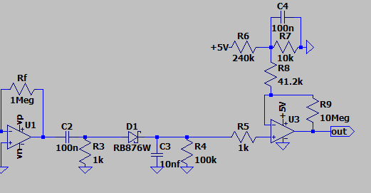
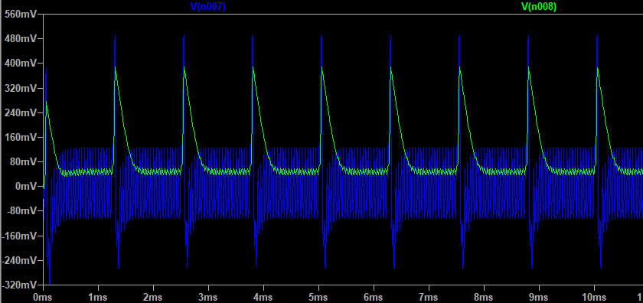
Peak hold circuit
To make the pulses last longer
With a Schottky diode (low voltage)
The voltage slowly decrease with R4
No more negative voltage thanks to the diode

Slide 18
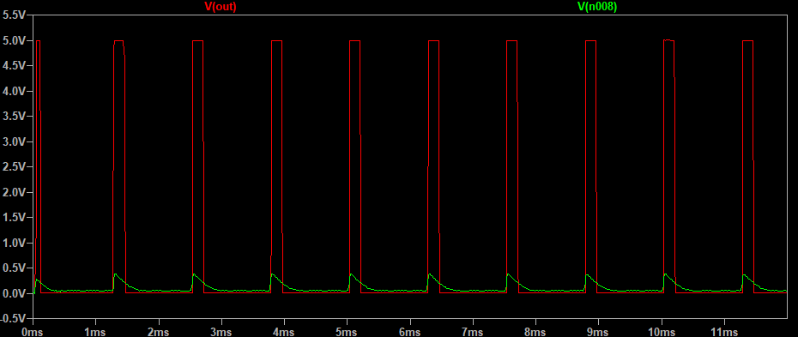
Comparator with hysteresis (Schmitt trigger)
To get binaries output for the IC with full amplitude (here +5V)
V_{ref}=200mV if V_{out}=0V
V_{ref} = 220mV if V_{out}=5V
Hysteresis of 20mV to prevents ripple
Resistor bridge on LTSpice but in “real life” we would use a true voltage reference (Zener)

